Slide 1
November 2016
The Cognitive Business of Agriculture

Slide 2
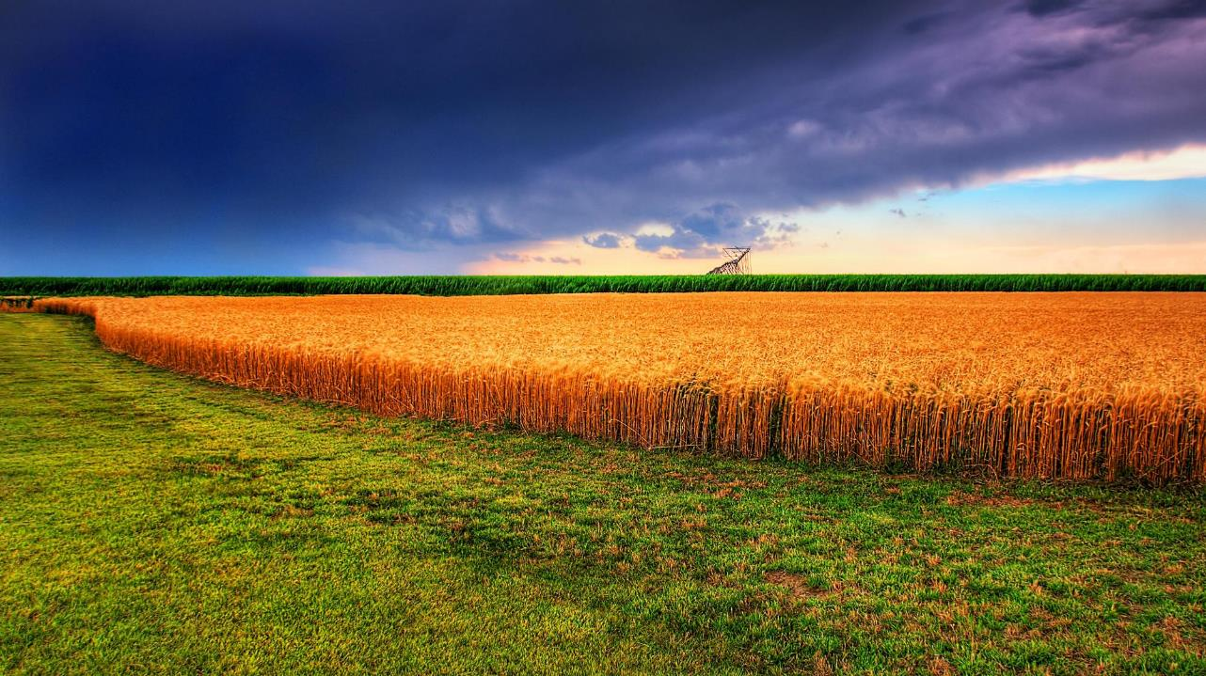
Cognitive Computing and Advanced Analytics are game changers in Agriculture. By leveraging the massive amounts of data available on crops, weather, soil, seeds, crop protection, regions, products, markets, and other data, agribusinesses can access a clear, informed view of the dynamics, potential, and volatility in the marketplace and in the fields.
Ultimately it allows farmers and agribusinesses to be proactive instead of reactive – and to turn uncertainty into opportunity.

Slide 3
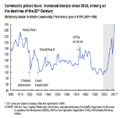
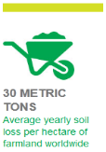
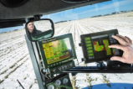
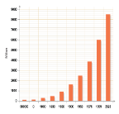
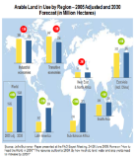
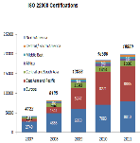
Global trends are presenting new opportunities in food systems
Commodity and energy prices are increasingly volatile
A wealth of data is becoming available
Dwindling natural resources are forcing change
World Population Growth
Agriculture gains in developing countries are changing global business dynamics
Demand for agricultural products is increasing
Food safety concerns are driving demand for greater transparency and regulation

Slide 4

IBM / The Weather Company: Differentiation
Proven Reliability
Data Precision
Distinctive Analytics
Intuitive Workflow
Multi-Platform Delivery
Support & Innovation

Slide 5

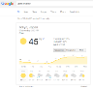
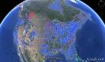



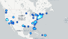
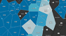
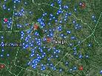

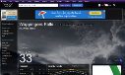
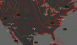
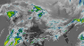
Our Advantage
Brand
Recognition
Unique
Data Sets
The Granularity
Required
Always - On
Solutions
The Weather Company is the #1 provider of weather data in the world, B2B & B2C
Ingestion of over 60 different types of data, output of ag related variables including soil variables, both near-term and seasonal forecast
Global coverage at 500m resolution out 15 days hourly & updated every 15 minutes for 2.2 billion locations
Unlock the advantage of
consumer insight & consumer emotion with SLA level platform

Slide 6

Our Story is About Data at Scale: Internet of Things
162 forecast models
serve as inputs to our forecast
15 Million
Pressures reading from mobile devices
>200,000 personal weather stations
Atmospheric data from 50,000 flights per day
Precision 100X Greater Coverage
Accuracy
Rated Number One
Speed
Forecast Updates every 15 Minutes
Notes:
Rob
As Hitesh just explained why IBM acquired the Weather Company to be the first step into being a data provider, let me know start with explaining WHY IBM chose the Weather Company to be that provider. Understanding this is critical to being able to position all the Weather offerings as superior to what is your market place. These advantages are what sets The Weather Company apart from its competitors and will give you an ‘edge’ to outshine your competitors.
Our goal is to be the top data provider of Weather – specifically providing weather for our thousands of analytic and integration customers as one example. Our analytics customer base is one natural target for our offerings which already have the capabilities to consume weather data to improve their businesses.
Be aware that The Weather Company is the largest and most trusted weather source in the industry. So when your customers ask you why they shouldn’t just use publicly available data... Tell them that The Weather Company provides the following:
The highest Precision: We have over 200,000 weather stations globally, provide coverage that is 100x greater than government sources, with 500 meter resolution
The best Accuracy: The Weather Company forecast data is rated number one in accuracy in every geo, by the independent monitoring agency, Forecast Watch
The fastest Speed: Our cloud-based delivery platform provides forecasts at scale for 2.2B locations worldwide, updated every 15-minutes
Weather impacts literally everything, and if your customers rely on free weather data to run their businesses, they’ll get what they pay for…

Slide 7
The Data Story is Also About Precision
Currents on Demand for
2.2 Billion Points On Earth
Full Coverage across APAC at Hyper-Local Resolution
Notes:
Objective: Tell the story of PRECISION
Because weather is hyper-local and can differ on a neighborhood by neighborhood basis. Here you can see the temperature differential within just a few kilometers. If you live within 2km of a weather reporting station, your forecast is 15% more accurate.

Slide 8

And Accuracy
162 Forecast Models
A Single Forecast Model Doesn’t Produce The Best Results; A Combination of 162 Models Does
Notes:
Objective of slides 12-14: Tell the story of ACCURACY
The best forecast model in the world doesn’t produce the best forecast. A combination of 162 models does.

Slide 9












Forecasts On-Demand
Lowest Error Rates
2015 US 1-3 Day Temperature Forecast RMS Errors
The Weather Company
Various government forecast models

Slide 10
24+
ingested per day in production
The SUN Platform
Terabyte
compressed
A cloud-based data platform that ingests large volumes & types of data
Delivers insights from precise weather data combined with location and other data sets
Enables companies to embed weather insights into decision support platforms to take take action
100s
Petabytes
analyzed and stored
in data lakes
15 Billion
handled per day
API requests
>100
supported today
data types
Notes:
Objective of slides 22-24: Introduce the SUN Platform
The work we do, however, is only as good as the foundation supporting it. The SUN platform is our cloud-based data platform that ingests more than 24 terabytes of data a day. More than 100 different types of data. The platform supports not only the ingestion of data, but the transformation so that it can be used for analytic purposes.

Slide 11
The Weather Company Data Packages
Weather Company Data – Lifestyle Indices
Air Quality + Pollen + Flu Outbreak + Tides + Aches & Pains + Breathing + Dry Skin + Frizz + Frost Potential + Golf + Heating & Cooling + Leisure Travel + Running Weather + Ski + Static Electricity
Weather Company Data – Cleaned Historical
Weather Company Data – Lightning Detection
Lightning
Weather Company Data – Seasonal Forecast
Seasonal & Sub-seasonal
Weather Company Data – Severe Weather
Power Disruption + 15 day probabilistic tropical forecast + Storm Reports + StrikeZone + HailZone + ShearVision + HailVision + RainVision + SnowVision + IceVision
Weather Company Data – Enhanced Current Conditions
Currents on Demand + Personal Weather Station Observations including Bounding Box & Time Series
Weather Company Data – Enhanced Forecast
Precipitation Forecast + 15 Minute Forecast + 15 Day - Hourly Forecast + 15 day gridded and polygonal forecast data
Weather Company Data – Historical
Standard Historical Observations
Weather Company Data – Core
Current conditions (site-based & time series observations) + Daily Forecast (3-, 5-, 7-, 10-Day) + 2-Day Hourly Forecast + Intraday Forecast (3-, 5-, 7-, 10-Day) + Weather Alert Headlines & Details (U.S., Canada, Europe) + Daily & Monthly Almanac + Location Mapping Services + Radar Images + Satellite Images + Current condition and forecast visualizations
Historical
Current
Immediate Future out to 15 Days
Seasonal
Notes:
Objective: Underscore value of weather data in decision making; highlight that probabilistic will be available next year.
And probabilistic forecast data will be available in key weather data packages from The Weather Company early next year. At present, we offer a number of options – historical, current and forecast data that can be used to analyze, predict and make decisions.
Site Based Weather Observations
Weather observations from stations and crowd-sourced sensors including temperature, wind, humidity, pressure, dew point, visibility, and UV Index
Severe Weather Reports
Hail (US only), tornado, wind, hurricane, snow, rain, ice, and lightning reports in real-time and historical observations
Weather Imagery
Radar, doppler, and satellite imagery updated 5-60 minutes.
Road Conditions
Accumulations and intensity of rain, snow, and ice
Weather Alerts
Severe weather, wildfire, and earthquake alerts in real-time
Tropical Storms
Probabilistic hurricane forecasts up to 15 days; water levels, surges, and wave height levels up to 48 hours – note this will be updated in 2017 to include probabilistic capabilities
Weather Forecasts
Hyper-local weather forecasts, including 1-hour windows up to 24 hours and 6-hour windows 1-15 days in the future. Includes severe weather and storm path predictions - note this will be updated in 2017 to include probabilistic capabilities
Seasonal Forecast
Comprehensive long-range forecast beyond traditional 15-day forecast. Temperature and precipitation anomaly predictions extend 4 months into the future.

Slide 12




Media & Entertainment
Travel & Transportation
Energy & Utilities Oil & Gas
Agriculture
Insurance & Financial Services
Retail
Delivering Better Business Outcomes
DECISIONS
Weather Solutions & Use Cases
Notes:
Objective of slides 25 – 31 – Tell the story through USE CASES.
At the end of the day, the most precise, accurate data…at scale yields insights that drive better decisions...sooner, which lead to more favorable outcomes. Let’s take a look at some of the solutions The Weather Company offers and the use cases that show them in action.

Slide 13
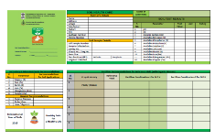
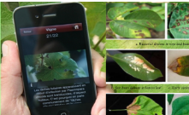




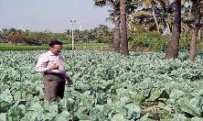
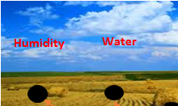




Agronomic business advisor for deep agricultural insights
Use Cases
Precision Fertilizer Application
Fertilizer requirements based on soil card information
GIS mapping of various crops and soil types
Analysis of fertilizer required at regional areas
Predictions and analysis
System for Crop Disease Identification
Identify diseases from image
Generate advisories for user
Regional warning system based on disease location analysis
Provide inputs to supply chain management
Fertilizer Application
Precision Irrigation
Crop Disease Identification
Sensor Integration
Recommendation Engine
Suggest best time for planting
Align crop profile with weather profile
Short and long term forecasts
Input parameters include fertilizer, water, insecticide, etc.
Sensors Integrated with Equipment
Automatic enablement of water dissipation units, fertilizers, etc.
Saves excess or deficient dissipation
Enhanced production with optimal dissipation
Innovations
Satellite Imagery
Vegetation Index
Soil Moisture Technology
Predictive Weather Analytics
Use agricultural insights to predict crop yields and understand impact on your financial and operational performance …

Slide 14
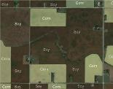


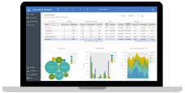
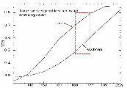


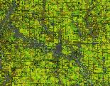
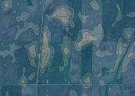

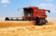
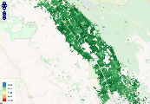
Potential client use cases based on agriculture data and advanced insight
Crop Data & Insight
Precision Ag Applications
Operational Use Cases
Based on Crop Yield Predictions
Plan to grow a crop
Seeding/ planting
Supply forecasting for raw materials in client products
Analyze impact of fluctuations in supply on ability to meet customer demand
Determine raw material supply’s impact on global commodities pricing
Use seasonal crop yield forecasts to determine hedging policies
Employ marketing and advertising campaigns to balance supply and demand
Explore commodity purchasing contracts with new suppliers
Employ product value engineering
Reduce indirect product costs via supply chain optimization
Nurture crop growth
Protect crop growth
Monitor/adjust crop growth
Harvest crop

Slide 15
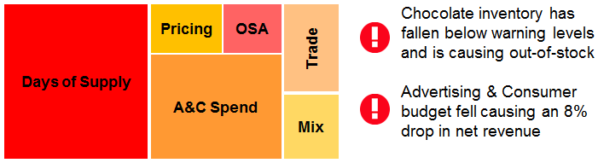
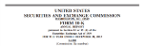


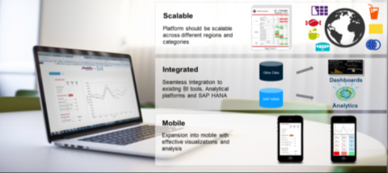


Scalable Analytics for New Insights: Integrating Agronomic Insights for Business Early Warning Systems
Business early warning analytical models combined with yield predictions to provide performance-based insights
Understand & Collect Data
Early Warning System
Analytics-generated alerts indicating possible gaps in performance Proactively address potential risks and opportunities
Consumable Visualizations: Evidence-based Recommendations
A visualization dashboard to show possible views to consume analytical insights & various performance metrics Align various stakeholders on most impactful KPIs across the organization
Financial Data
Operations Metrics
Grain has fallen below warning levels and is causing out-of-stock
Fall weather forecasts create new crop protection recommendations
Market Data
Other External Metrics
Analyze Existing Systems
BI Systems
Financials
$
Operations Systems
Dealer Systems

Slide 16

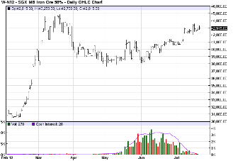

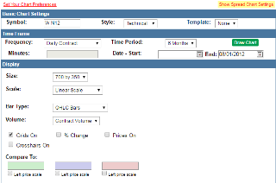
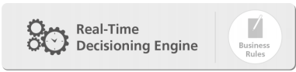
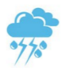



Potato sample use case with IBM advanced analytics recommendations engine
Sample Scenario
Potato Production Inputs
Mitigation Strategies
Production Labor
Farming
Commodity
Pricing
Illustrative
Illustrative
IBM performs analysis on worldwide crop
yields for potatoes
Predicting significant market supply shortage in the next 6 -12 months
Strategy 1: provide daily/weekly ‘next best recommendation’ to farmers on mitigation strategy and optimal harvest time
Strategy 2: prepare marketing campaign focused on other agriculture in portfolio
Strategy 3: work with local farmers or tier II suppliers to increase crop yields
Weather
Marketing &
Advertising
Levers
Cultivation
Requirements
Purchase Contracts & Other Costs

Slide 17

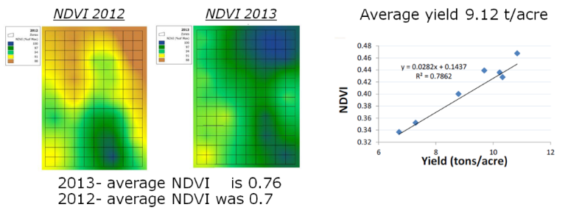

Scalable Analytics: Improving crop yield and quality while reducing water consumption in the vineyard
The challenge:
Solution:
Improve Crop yields and grape quality by precision irrigation solution
Conserve water due to drought
Remote Satellite image processing for normalized vegetation index (NDVI)
Evapo-transpiration modeling & plant modeling to determine irrigation schedule
Increased Yield 23%
Water conservation 20%
Reduced variability, 10% higher grape quality
Results:
Gallo & IBM:
2014 Vintage Report Innovation Award for prototype system
20 Jan. 2015
Notes:
Sat Images including IR
Remote Image Processing for normalized vegetation index (NDVI)
Evapo-transpiration modeling & plant modeling to determine irrigation schedule
17

Slide 18
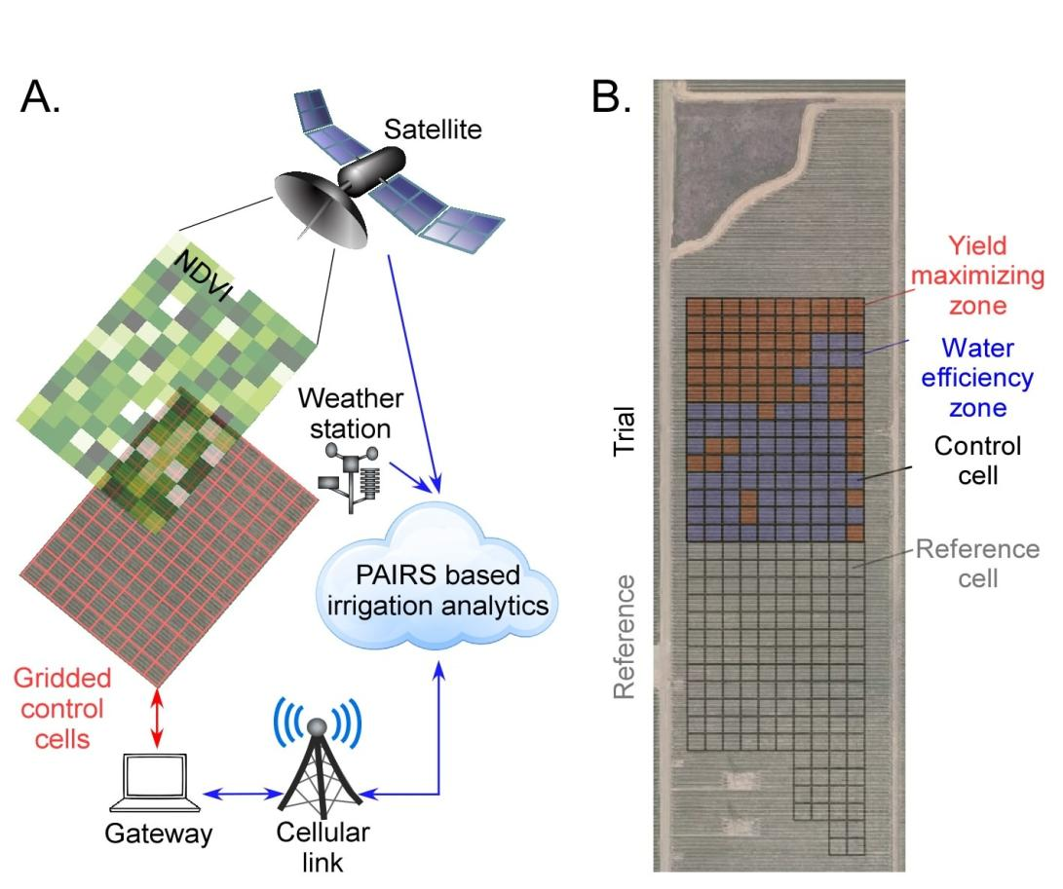
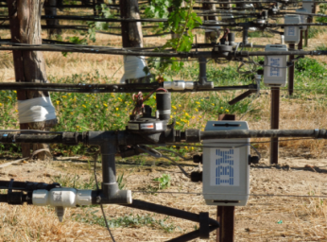
Scalable Analytics: Improving crop yield and quality while reducing water consumption in the vineyard
Predictive weather model
Weather station data
Evapo-transpiration modeling
Control a smart variable rate irrigation system
Control electronics
box and node
Double drip line with
control electronics.
© 2015 IBM Corporation
Notes:
Sat Images including IR
Remote Image Processing for normalized vegetation index (NDVI)
Evapo-transpiration modeling & plant modeling to determine irrigation schedule
18

Slide 19
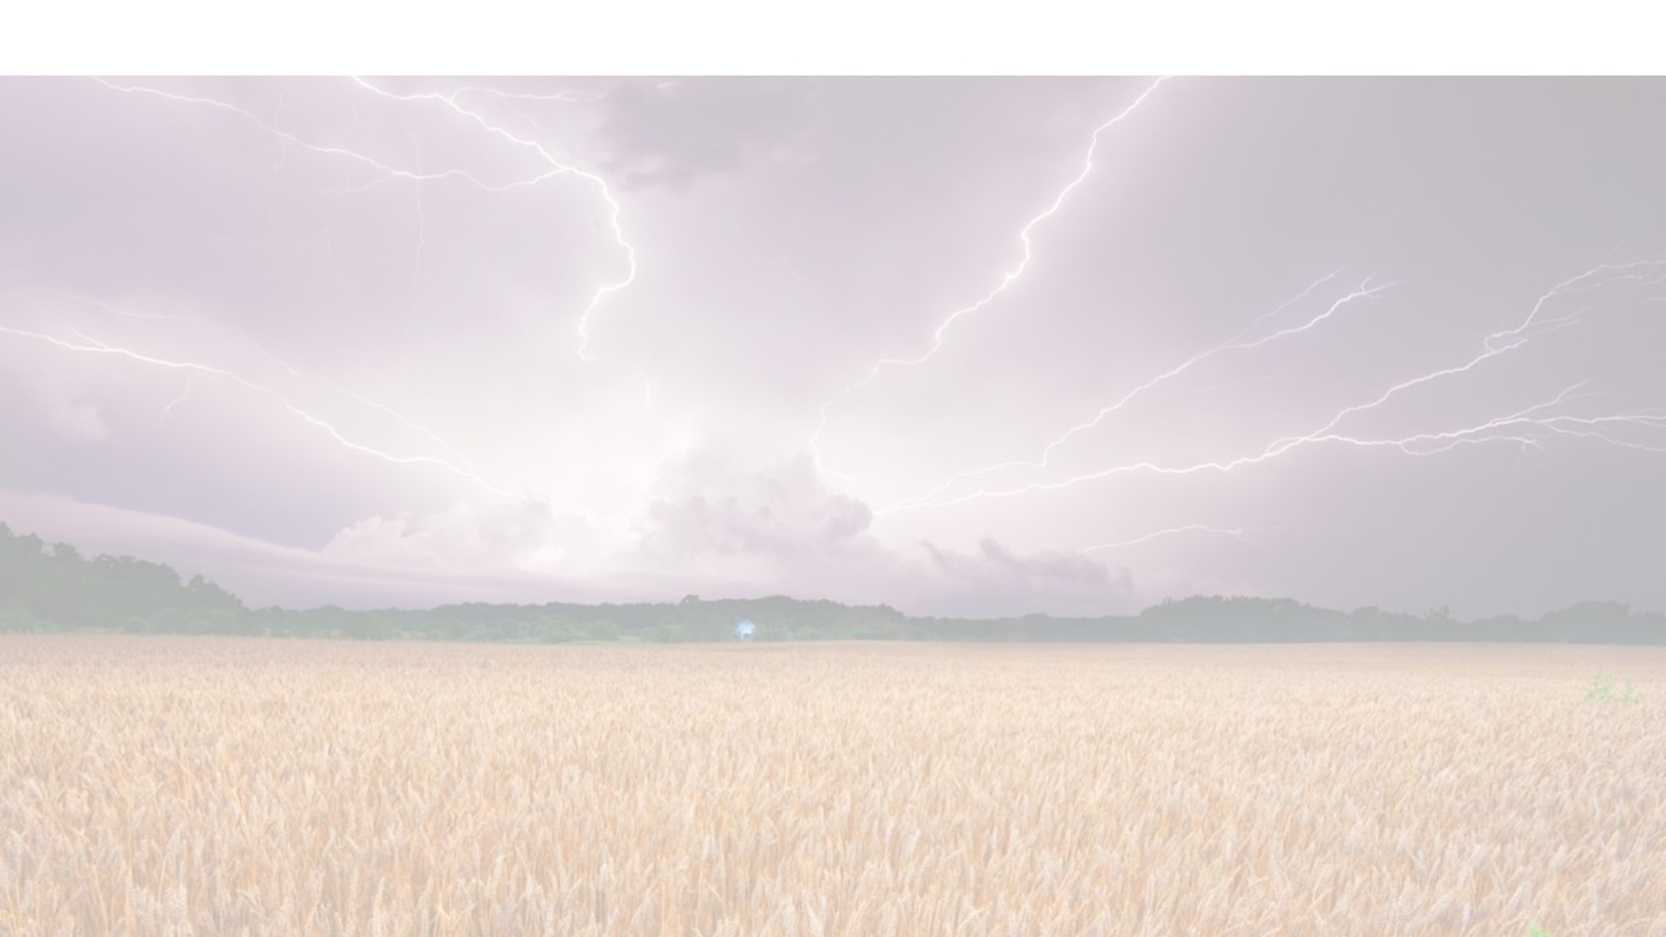




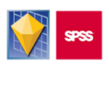



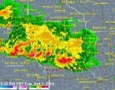
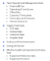
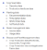
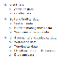
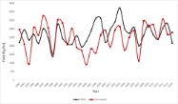

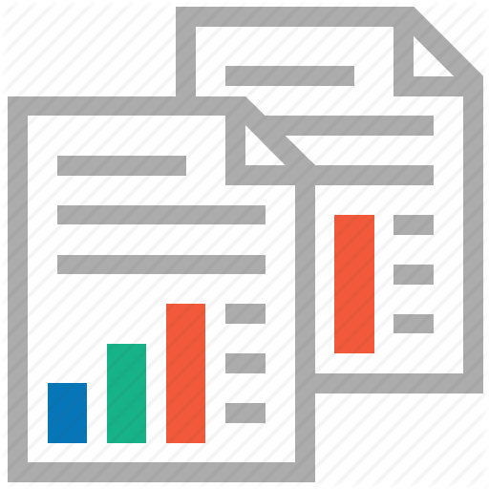
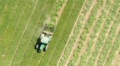
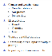
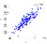
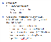
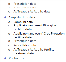
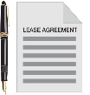

IBM Solution : Scalable Platform
Sense
Analyze
Act
Feedback Loop
Forecast yield and incorporate team adjustments
Why is there a yield gap or surplus?
Evaluate:
Irrigation Management
Fertigation Management
Optimal Harvest Time
Commodities price for Crop
Weather
Normalized Difference Vegetation Index
Social media
Market price
Year to date yields
YES or No
Are changes in yield impacted by controllable levers?
DATA / TECHNOLOGY
Ingest Weather, NVDI, Market price, YTD yields, social media
Forecast yield based on changes in input data
Incorporate client team adjustments
Store results to back test accuracy
Interactive dashboard to investigate local yields or different crops, view results of analysis and reports to evaluate positions and take action
Mkt Price Data
YTD Yields Data
Weather Data
NDVI
Social Media
Store Results
Models
Proprietary Dashboard
INTERFACE FUNCTIONALITY
Weather Forecast
NDVI Index
Investigate drivers of yield results
View model output
View
Yields
View Reports
Yield
Forecast
Model
Documentation
& Training
Dashboard
w/ Weather-
Based Insight
DELIVERABLES
Enhanced
Business
Case

Slide 20





The Weather Company IS
the most Precise, Accurate and Timely Data Source
Precision
100x greater times coverage
Accuracy
Rated number ONE
Speed
Forecast updates every 15 minutes
Notes:
Durjoy to Russ:
We have had some great discussions today and I want to wrap up but saying no one comes close to what we deliver at The Weather Company. We are the most precise, accurate and timely provider of weather data in the market. I would like to talk about next steps Russ and how we can help your organization. I would like to propose a follow-up meeting for next Thursday so my team can spend 2 hours with your team to do an interactive workshop. I would like to show your team the value weather can bring to your organization and how IBM differentiates itself in the market with respect to our unique capabilities around precision, speed and accuracy of weather data. What do you say?
Russ:
Excellent. That sounds like a great next step. I will check with my team for next Thursday and get back to you tomorrow.

Slide 21
Details for each package can be found in these links.
https://docs.google.com/document/d/15Ru_3wdMgpbM4aOCm-4qNAnRfjx2w-Ruw3lnr8Hnodk/edit# https://docs.google.com/document/d/1ft6XnmgM4PdZk5q0ap8p9d9cRu6rIB6peAnt7YUinEM/edit These highlights of the packages will probably be useful for agricultural use cases:
1-15 day hourly forecasts - 500m global grid of precision forecasts. They enter a lat/lon of a farm and receive that precise location forecast. Forecasts update every 15 minutes! **Forecasts for solar irradiance, soil moisture, soil temperature and evapotranspiration will be available soon ***
Current Observations - 500m global grid of current observations. This also includes the ability to pull from personal weather stations as well!​
​Seasonal Forecasts - pull the anomaly forecast for any location for precipitation and temperature for months 1-7​
​Growing Degree Day Forecasts​ - based on temperature of 50 degrees F.
Frost Forecast - out 15 days - provides likelihood of frost
Cleaned Historical API - provides quality controlled and gap filled historical observations back to 1979. This API provides variables specific to Ag such as:
Solar Irradiance
Soil Moisture (0-10cm & 10-40cm)
Soil Temperature (0-10cm & 10-40cm)
Evapotranspiration
Surface Runoff
​We certainly have many other APIs and forecast options, so if you have an idea of something they'd like to see which is
not included, please let us know as there's a good chance we have it or will have it soon!​

Slide 22

Thank
You
IBM / The Weather Company

